Slide 1
MODERN OPERATING SYSTEMS
Third Edition
ANDREW S. TANENBAUM
Chapter 10
Case Study 1: LINUX
Tanenbaum, Modern Operating Systems 3 e, (c) 2008 Prentice-Hall, Inc. All rights reserved. 0-13-6006639

Slide 2
History of UNIX and Linux
UNICS
PDP-11 UNIX
Portable UNIX
Berkeley UNIX
Standard UNIX
MINIX
Linux
Tanenbaum, Modern Operating Systems 3 e, (c) 2008 Prentice-Hall, Inc. All rights reserved. 0-13-6006639

Slide 3
UNIX/Linux Goals
Designed by programmers, for programmers
Designed to be:
  Simple
  Elegant
  Consistent
  Powerful
  Flexible
Tanenbaum, Modern Operating Systems 3 e, (c) 2008 Prentice-Hall, Inc. All rights reserved. 0-13-6006639

Slide 4
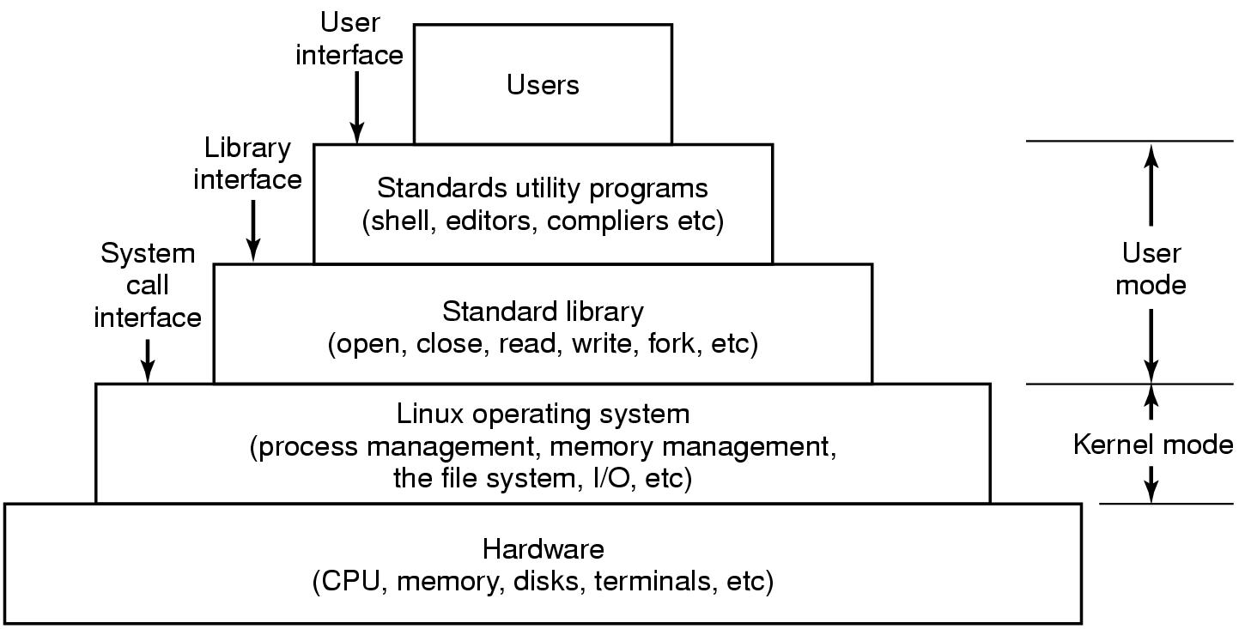
Interfaces to Linux
Figure 10-1. The layers in a Linux system.
Tanenbaum, Modern Operating Systems 3 e, (c) 2008 Prentice-Hall, Inc. All rights reserved. 0-13-6006639

Slide 5
Linux Utility Programs (1)
Categories of utility programs:
File and directory manipulation commands.
Filters.
Program development tools, such as editors and compilers.
Text processing.
System administration.
Miscellaneous.
Tanenbaum, Modern Operating Systems 3 e, (c) 2008 Prentice-Hall, Inc. All rights reserved. 0-13-6006639

Slide 6
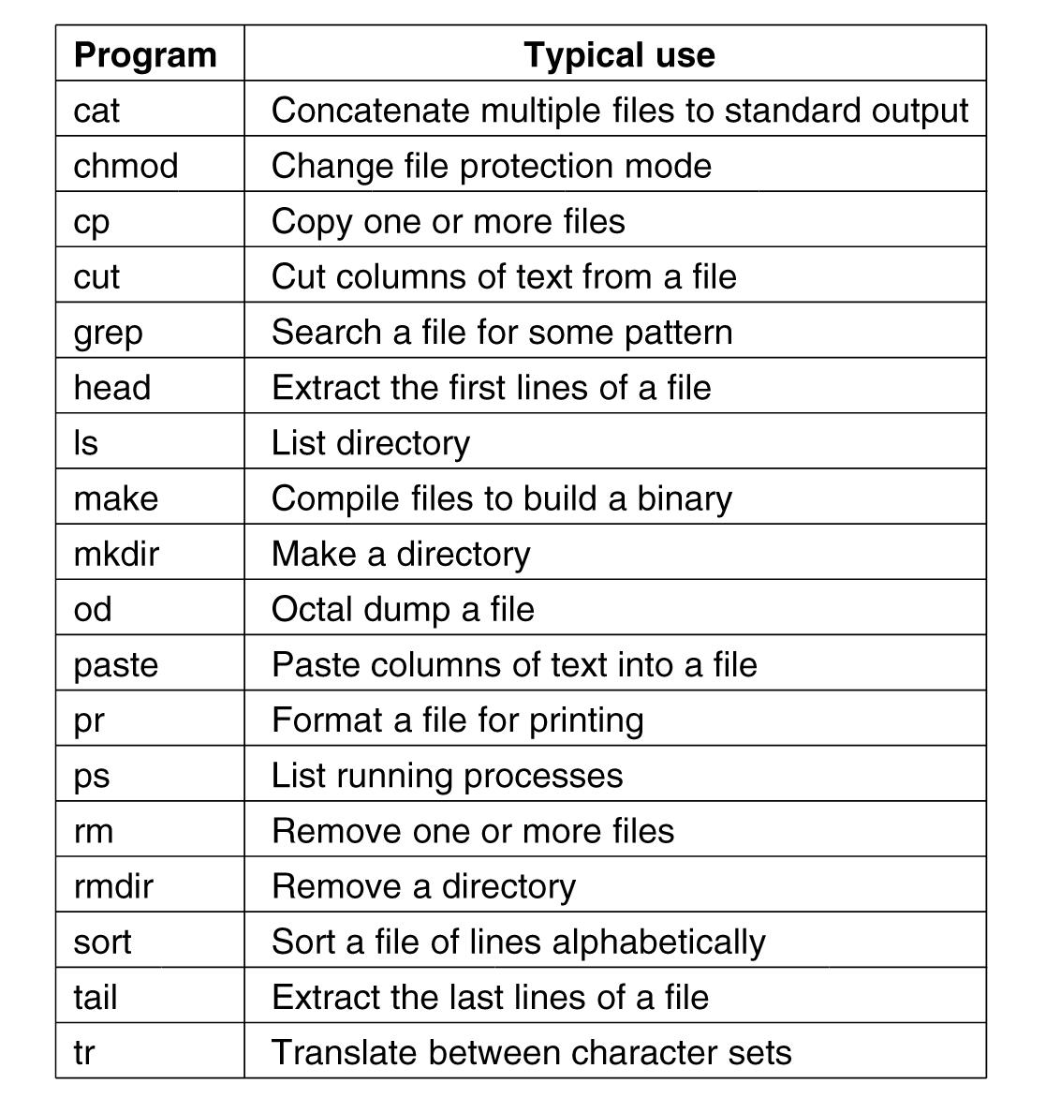
Linux Utility Programs (2)
Figure 10-2. A few of the common Linux
utility programs required by POSIX.
Tanenbaum, Modern Operating Systems 3 e, (c) 2008 Prentice-Hall, Inc. All rights reserved. 0-13-6006639

Slide 7
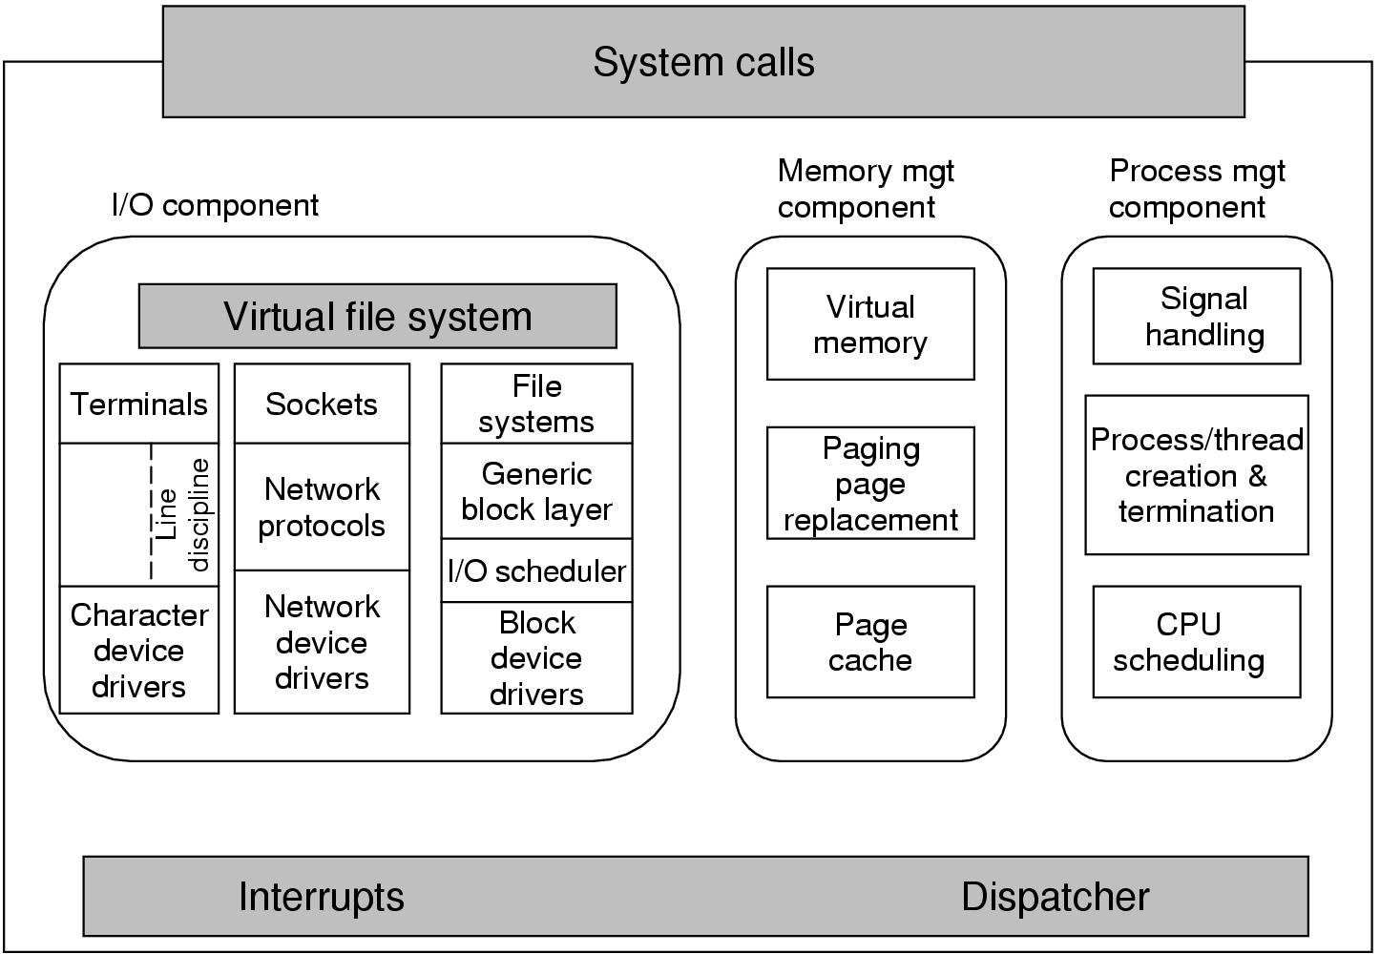
Kernel Structure
Figure 10-3. Structure of the Linux kernel
Tanenbaum, Modern Operating Systems 3 e, (c) 2008 Prentice-Hall, Inc. All rights reserved. 0-13-6006639

Slide 8
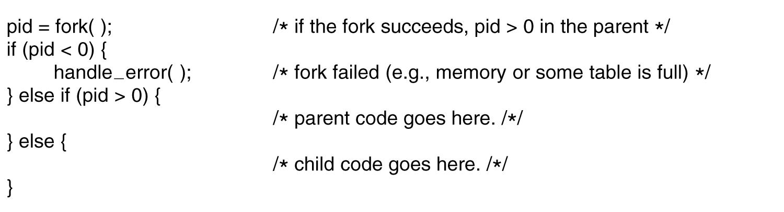
Processes in Linux
Figure 10-4. Process creation in Linux.
Tanenbaum, Modern Operating Systems 3 e, (c) 2008 Prentice-Hall, Inc. All rights reserved. 0-13-6006639

Slide 9
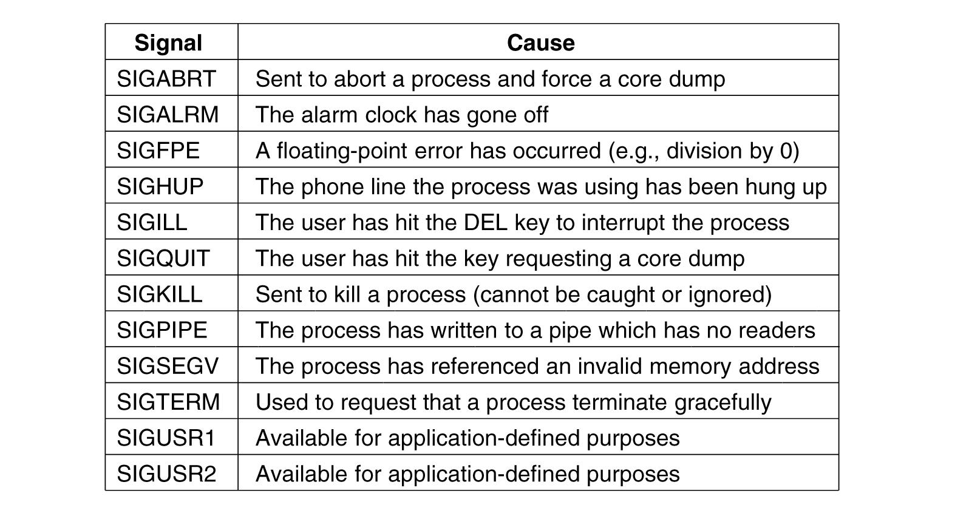
Signals in Linux (1)
Figure 10-5. The signals required by POSIX.
Tanenbaum, Modern Operating Systems 3 e, (c) 2008 Prentice-Hall, Inc. All rights reserved. 0-13-6006639

Slide 10
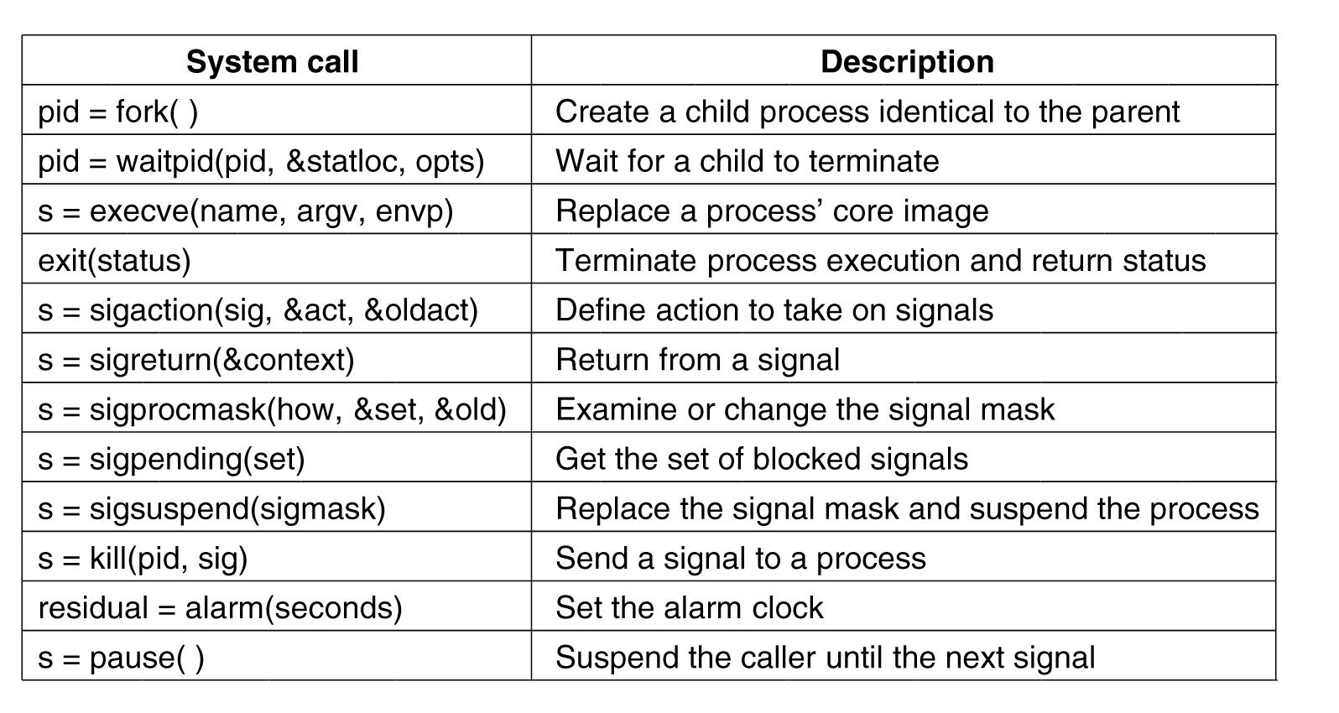
Process Management
System Calls in Linux
Figure 10-6. Some system calls relating to processes.
Tanenbaum, Modern Operating Systems 3 e, (c) 2008 Prentice-Hall, Inc. All rights reserved. 0-13-6006639

Slide 11
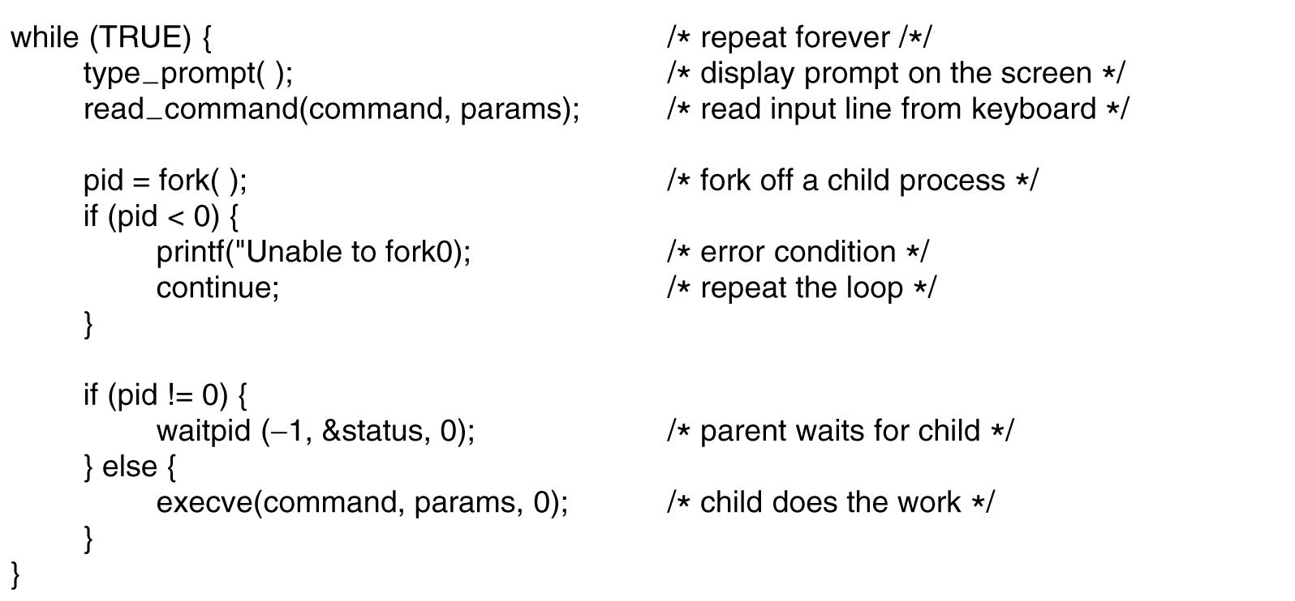
A Simple Linux Shell
Figure 10-7. A highly simplified shell.
Tanenbaum, Modern Operating Systems 3 e, (c) 2008 Prentice-Hall, Inc. All rights reserved. 0-13-6006639

Slide 12
Implementation of Processes and Threads
Categories of information in the process descriptor:
Scheduling parameters
Memory image
Signals
Machine registers
System call state
File descriptor table
Accounting
Kernel stack
Miscellaneous
Tanenbaum, Modern Operating Systems 3 e, (c) 2008 Prentice-Hall, Inc. All rights reserved. 0-13-6006639

Slide 13
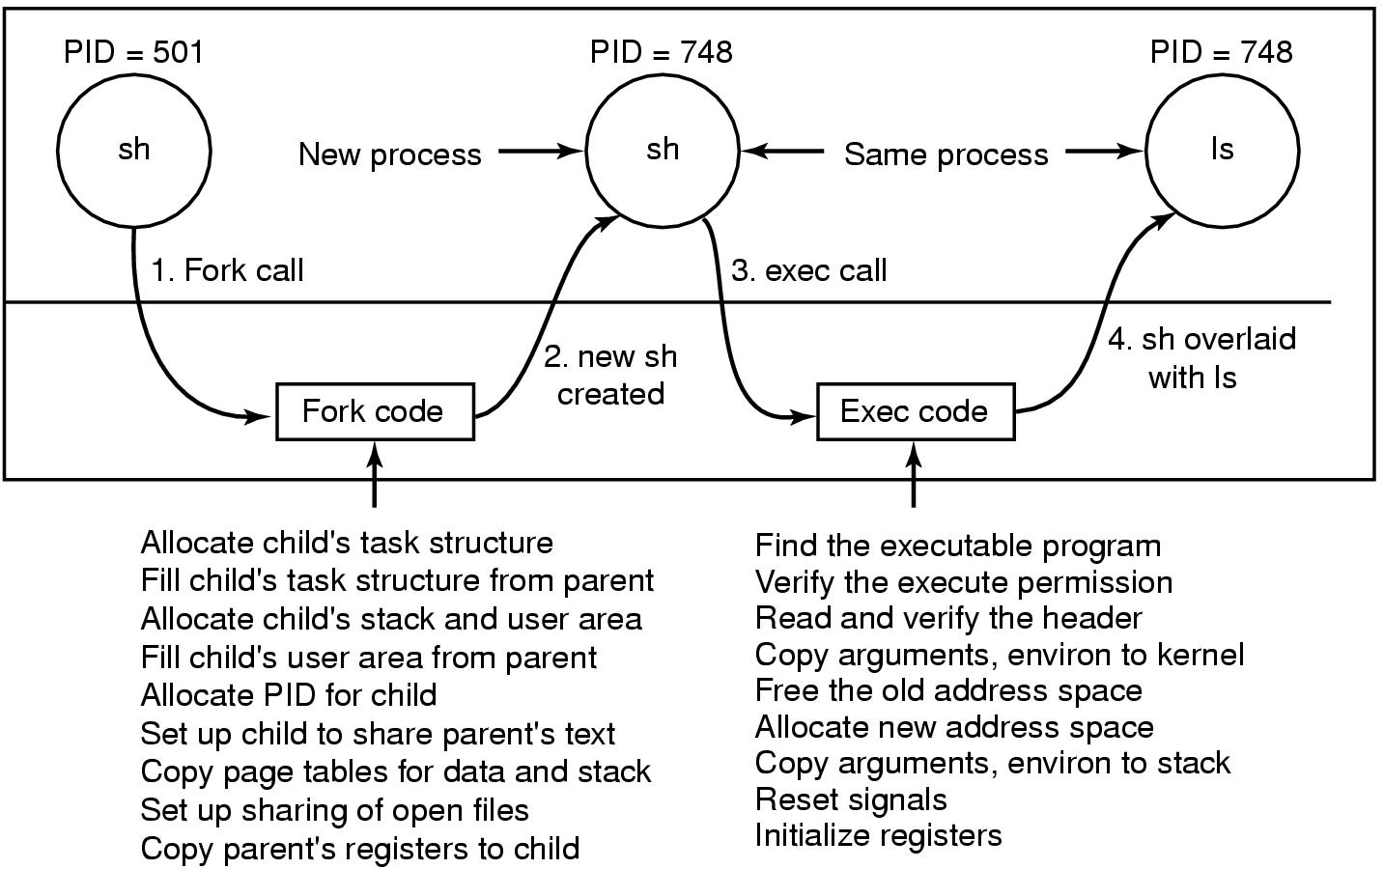
Implementation of Exec
Figure 10-8. The steps in executing the command
ls typed to the shell.
Tanenbaum, Modern Operating Systems 3 e, (c) 2008 Prentice-Hall, Inc. All rights reserved. 0-13-6006639

Slide 14
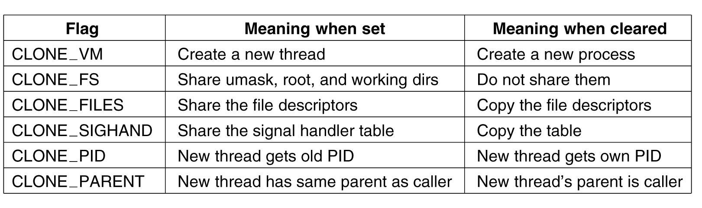
The Clone System Call
Figure 10-9. Bits in the sharing_flags bitmap.
Tanenbaum, Modern Operating Systems 3 e, (c) 2008 Prentice-Hall, Inc. All rights reserved. 0-13-6006639

Slide 15
Scheduling in Linux (1)
Three classes of threads for scheduling purposes:
Real-time FIFO.
Real-time round robin.
Timesharing.
Tanenbaum, Modern Operating Systems 3 e, (c) 2008 Prentice-Hall, Inc. All rights reserved. 0-13-6006639

Slide 16
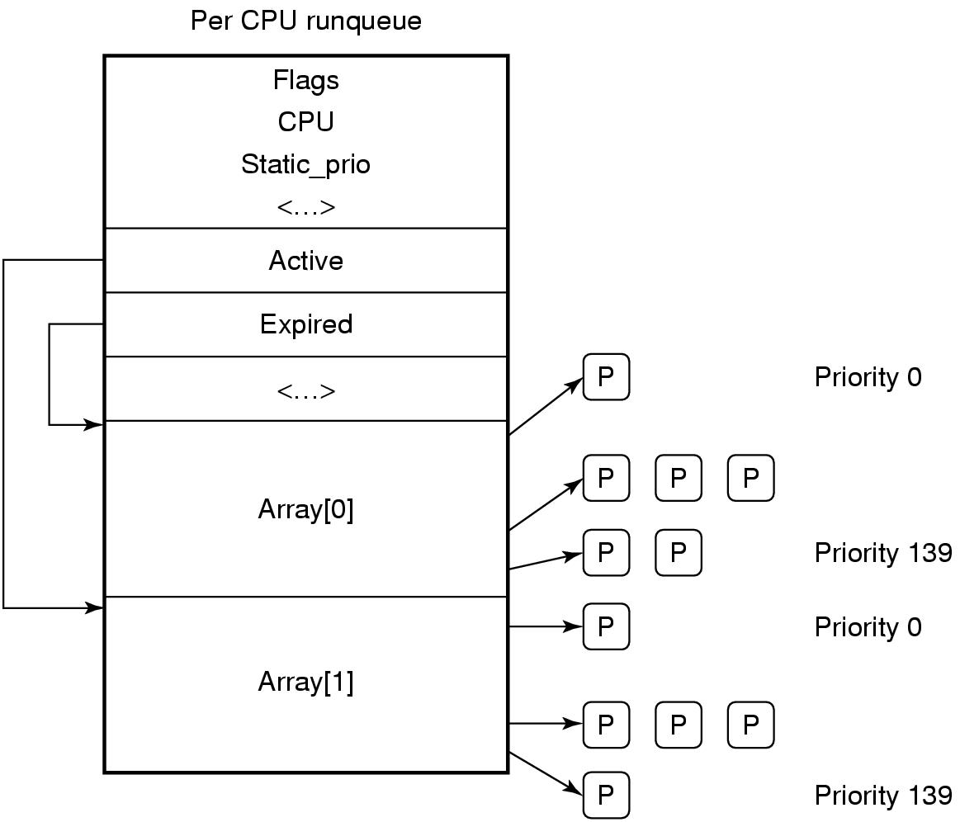
Scheduling in Linux (2)
Figure 10-10. Illustration of Linux runqueue and priority arrays.
Tanenbaum, Modern Operating Systems 3 e, (c) 2008 Prentice-Hall, Inc. All rights reserved. 0-13-6006639

Slide 17
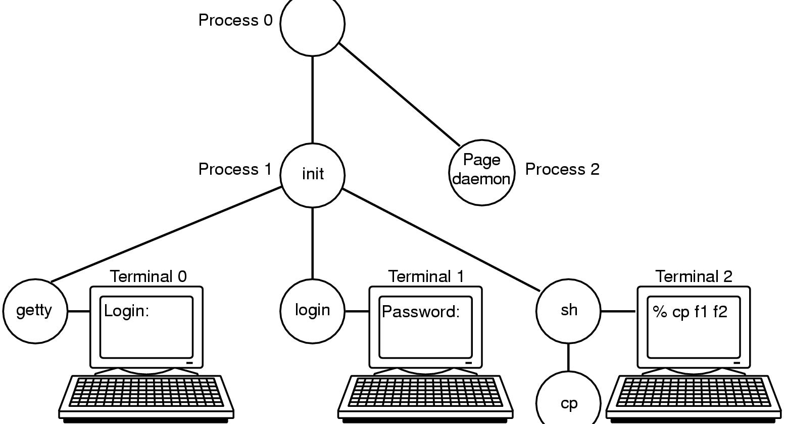
Booting Linux
Figure 10-11. The sequence of processes used to
boot some Linux systems.
Tanenbaum, Modern Operating Systems 3 e, (c) 2008 Prentice-Hall, Inc. All rights reserved. 0-13-6006639

Slide 18
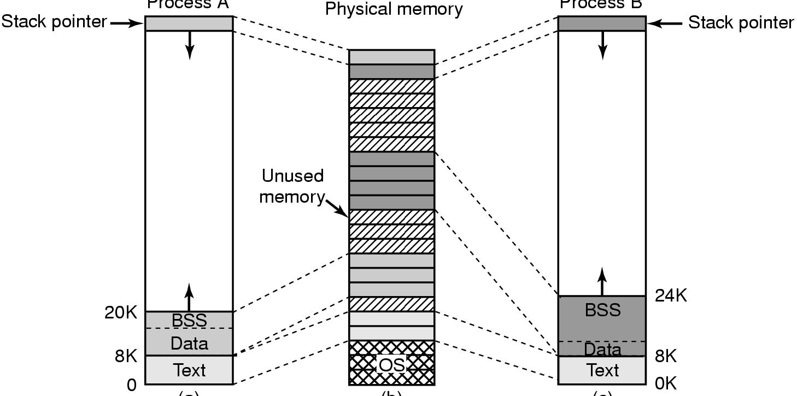
Memory Management in Linux (1)
Figure 10-12. (a) Process A’s virtual address space. (b) Physical memory. (c) Process B’s virtual address space.
Tanenbaum, Modern Operating Systems 3 e, (c) 2008 Prentice-Hall, Inc. All rights reserved. 0-13-6006639

Slide 19
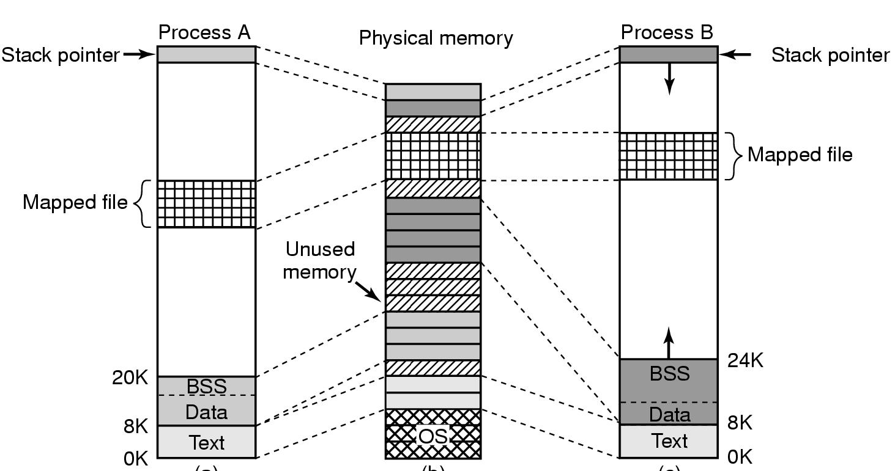
Memory Management in Linux (2)
Figure 10-13. Two processes can share a mapped file.
Tanenbaum, Modern Operating Systems 3 e, (c) 2008 Prentice-Hall, Inc. All rights reserved. 0-13-6006639

Slide 20
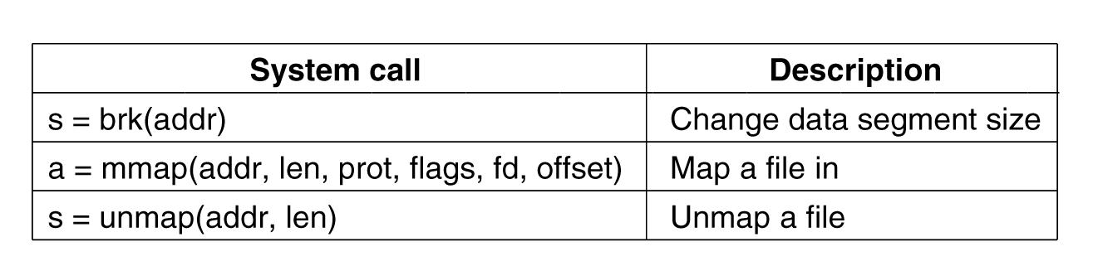
Memory Management
System Calls in Linux
Figure 10-14. Some system calls relating to memory management.
Tanenbaum, Modern Operating Systems 3 e, (c) 2008 Prentice-Hall, Inc. All rights reserved. 0-13-6006639

Slide 21
Physical Memory Management (1)
Linux distinguishes between three memory zones:
ZONE_DMA - pages that can be used for DMA operations.
ZONE_NORMAL - normal, regularly mapped pages.
ZONE_HIGHMEM - pages with high-memory addresses, which are not permanently mapped.
Tanenbaum, Modern Operating Systems 3 e, (c) 2008 Prentice-Hall, Inc. All rights reserved. 0-13-6006639

Slide 22
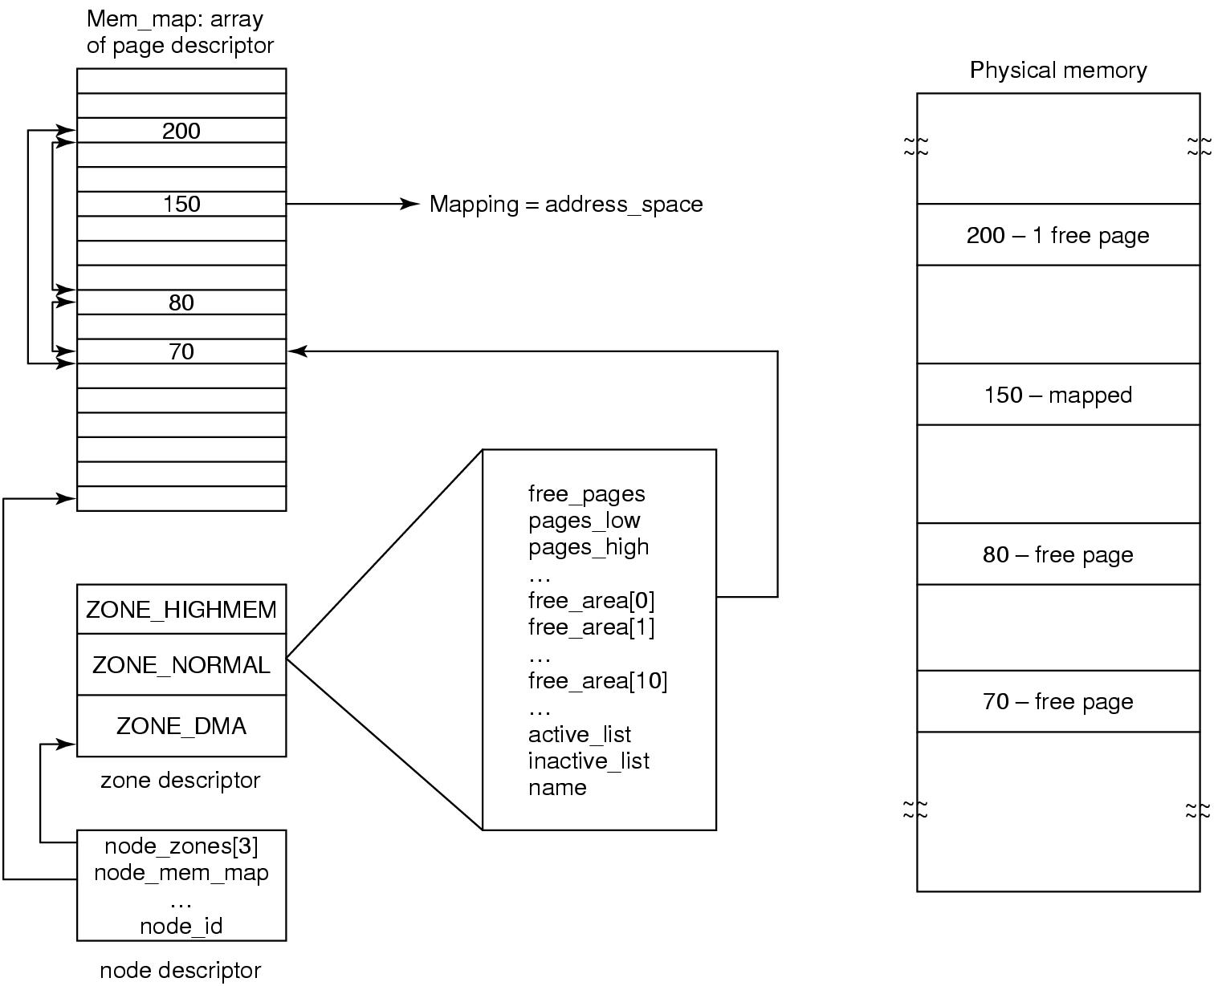
Physical Memory Management (2)
Figure 10-15. Linux main memory representation.
Tanenbaum, Modern Operating Systems 3 e, (c) 2008 Prentice-Hall, Inc. All rights reserved. 0-13-6006639

Slide 23
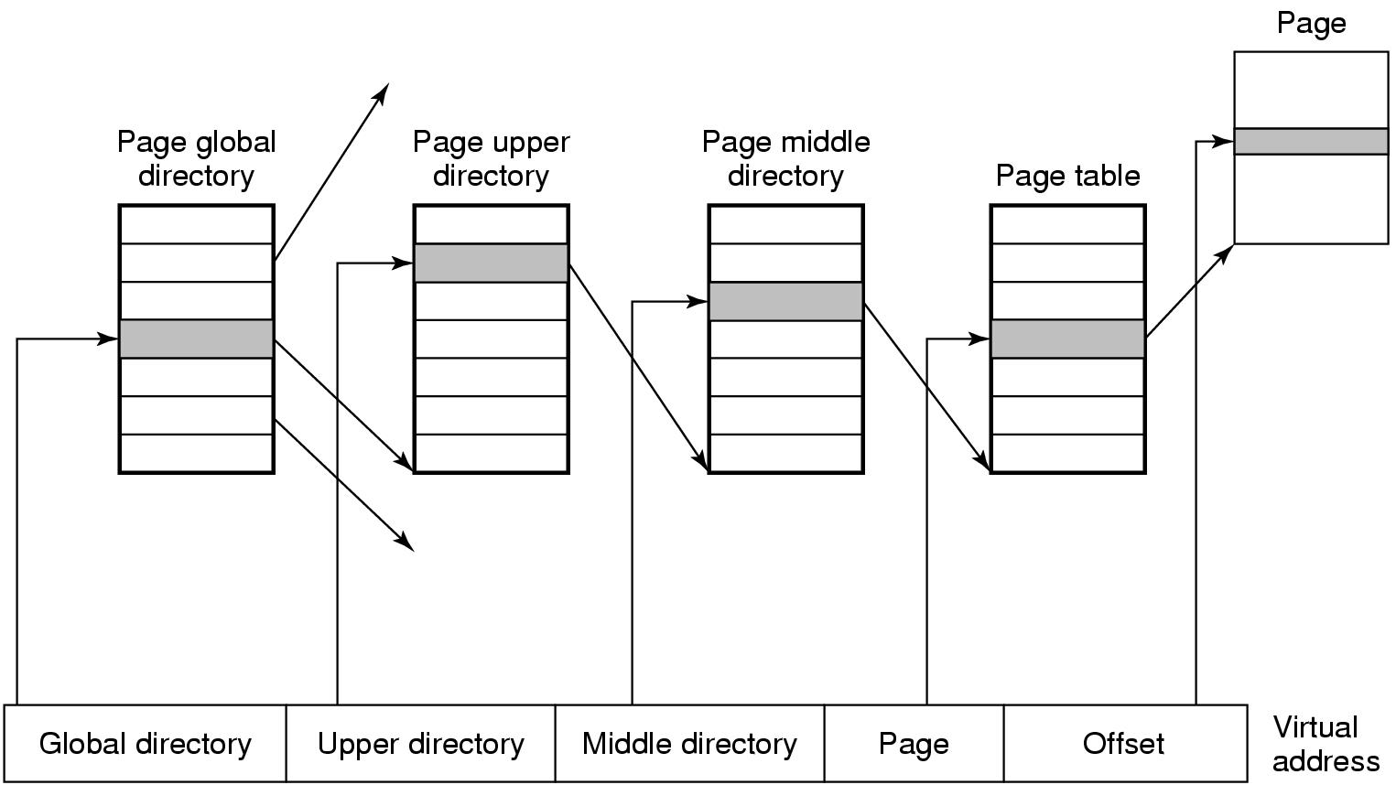
Physical Memory Management (3)
Figure 10-16. Linux uses four-level page tables.
Tanenbaum, Modern Operating Systems 3 e, (c) 2008 Prentice-Hall, Inc. All rights reserved. 0-13-6006639

Slide 24
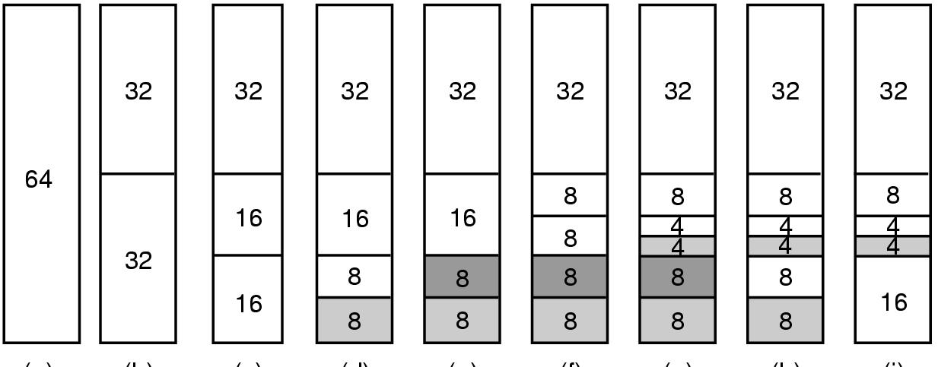
Memory Allocation Mechanisms
Figure 10-17. Operation of the buddy algorithm.
Tanenbaum, Modern Operating Systems 3 e, (c) 2008 Prentice-Hall, Inc. All rights reserved. 0-13-6006639

Slide 25
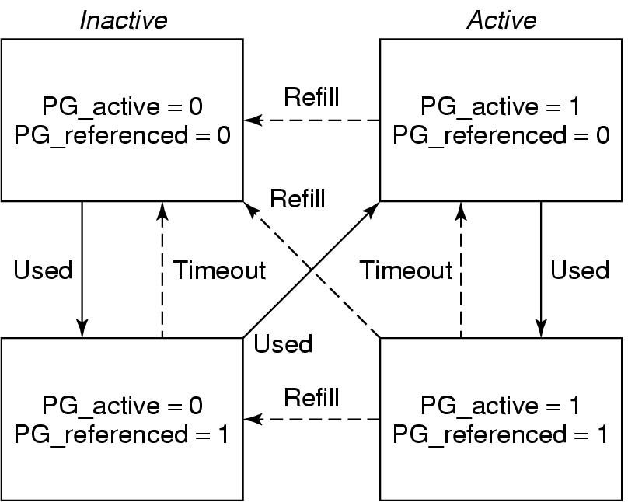
The Page Replacement Algorithm
Figure 10-18. Page states considered in the page
frame replacement algorithm.
Tanenbaum, Modern Operating Systems 3 e, (c) 2008 Prentice-Hall, Inc. All rights reserved. 0-13-6006639

Slide 26
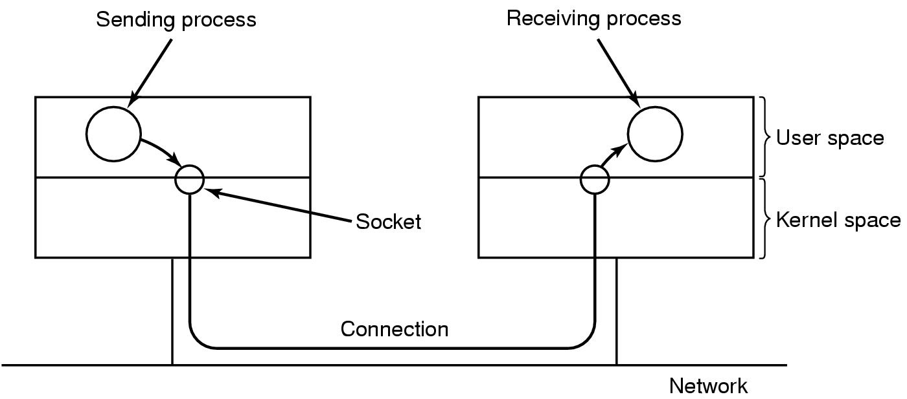
Networking (1)
Figure 10-19. The uses of sockets for networking.
Tanenbaum, Modern Operating Systems 3 e, (c) 2008 Prentice-Hall, Inc. All rights reserved. 0-13-6006639

Slide 27
Networking (2)
Types of networking:
Reliable connection-oriented byte stream.
Reliable connection-oriented packet stream.
Unreliable packet transmission.
Tanenbaum, Modern Operating Systems 3 e, (c) 2008 Prentice-Hall, Inc. All rights reserved. 0-13-6006639

Slide 28
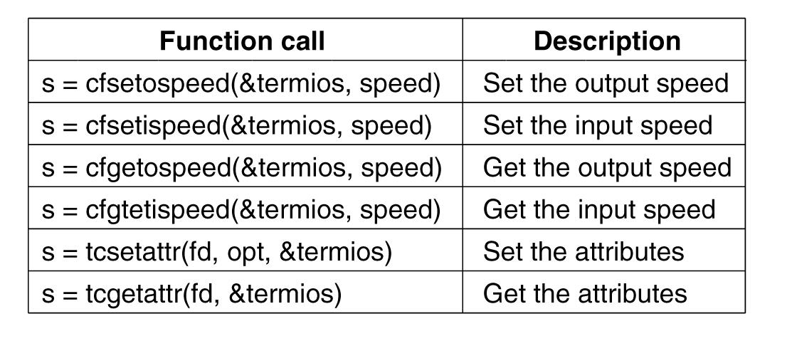
Input/Output System Calls in Linux
Figure 10-20. The main POSIX calls for managing the terminal.
Tanenbaum, Modern Operating Systems 3 e, (c) 2008 Prentice-Hall, Inc. All rights reserved. 0-13-6006639

Slide 29
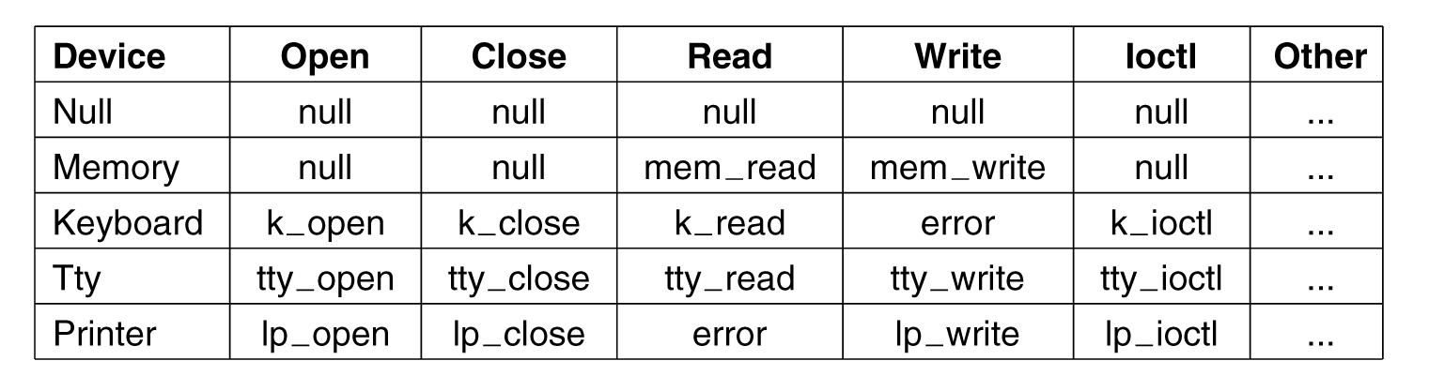
The Major Device Table
Figure 10-21. Some of the file operations supported
for typical character devices.
Tanenbaum, Modern Operating Systems 3 e, (c) 2008 Prentice-Hall, Inc. All rights reserved. 0-13-6006639

Slide 30
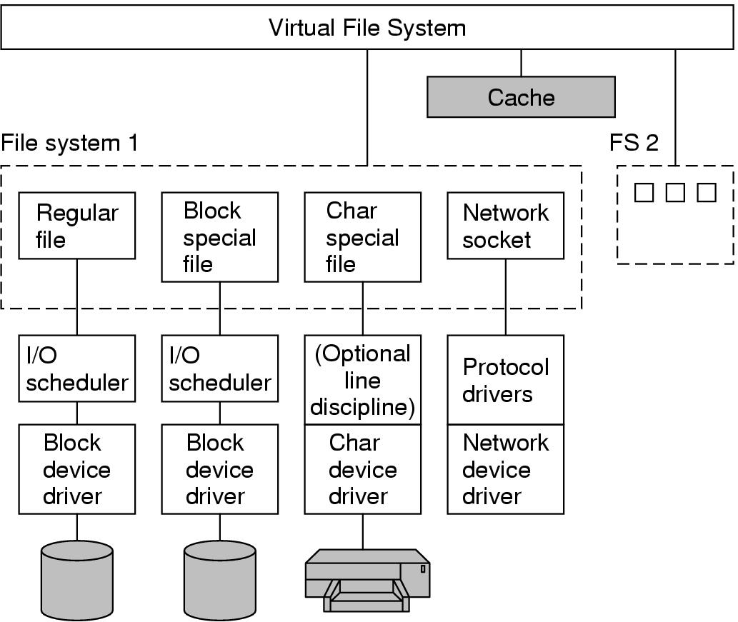
Implementation of
Input/Output in Linux (2)
Figure 10-22. The Linux I/O system showing one file system in detail.
Tanenbaum, Modern Operating Systems 3 e, (c) 2008 Prentice-Hall, Inc. All rights reserved. 0-13-6006639

Slide 31
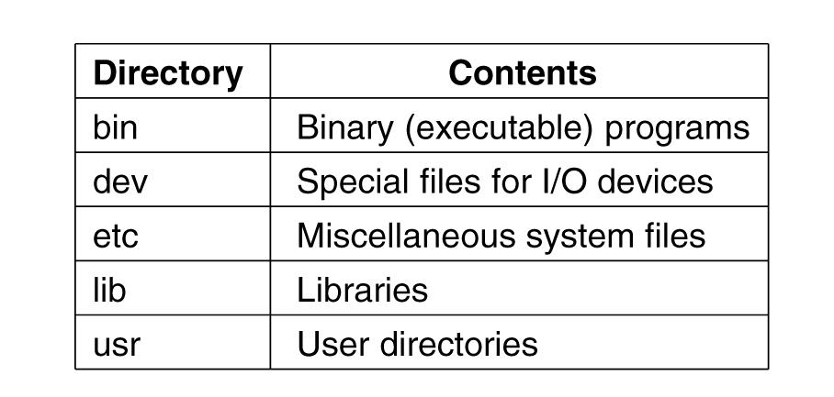
The Linux File System (1)
Figure 10-23. Some important directories
found in most Linux systems.
Tanenbaum, Modern Operating Systems 3 e, (c) 2008 Prentice-Hall, Inc. All rights reserved. 0-13-6006639

Slide 32
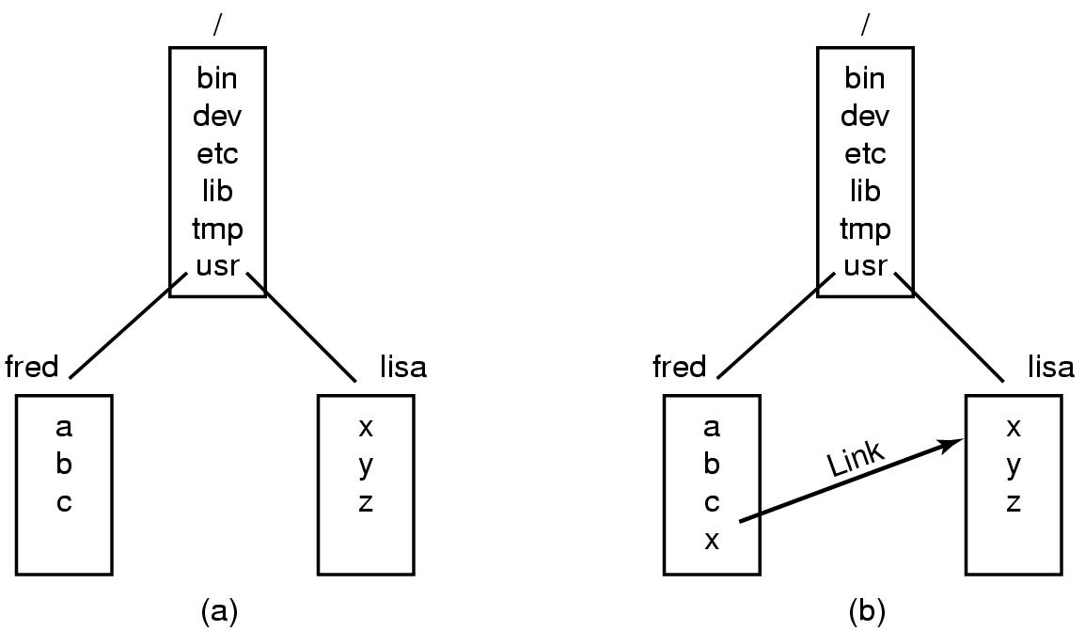
The Linux File System (2)
Figure 10-24. (a) Before linking. (b) After linking.
Tanenbaum, Modern Operating Systems 3 e, (c) 2008 Prentice-Hall, Inc. All rights reserved. 0-13-6006639

Slide 33
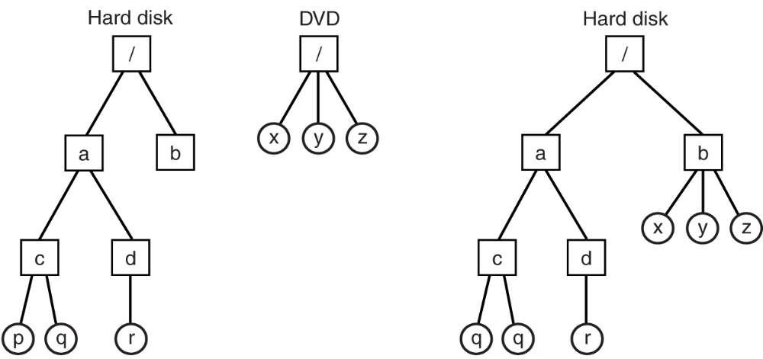
The Linux File System (3)
Figure 10-25. (a) Separate file systems. (b) After mounting.
Tanenbaum, Modern Operating Systems 3 e, (c) 2008 Prentice-Hall, Inc. All rights reserved. 0-13-6006639

Slide 34
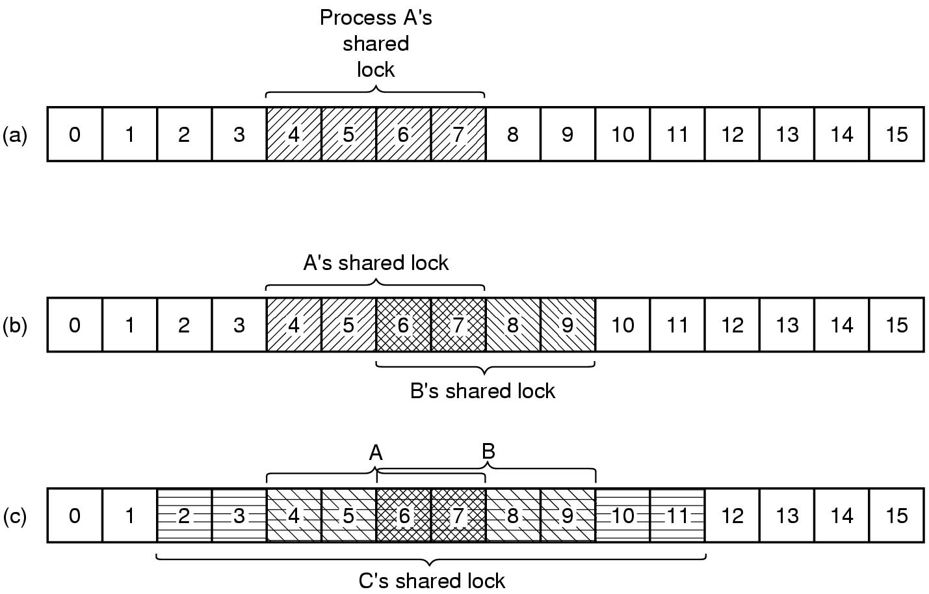
The Linux File System (4)
Figure 10-26. (a) A file with one lock.
(b) Addition of a second lock. (c) A third lock.
Tanenbaum, Modern Operating Systems 3 e, (c) 2008 Prentice-Hall, Inc. All rights reserved. 0-13-6006639

Slide 35
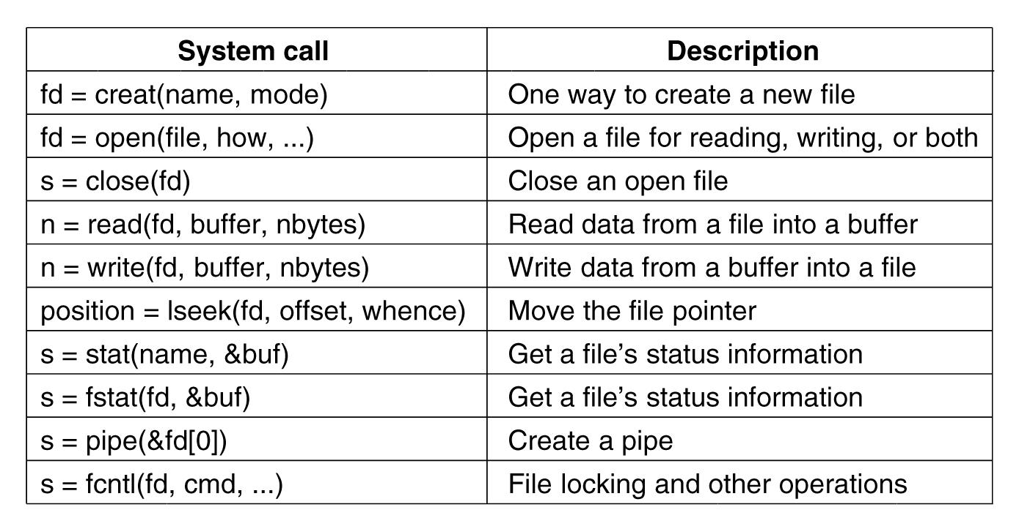
File System Calls in Linux (1)
Figure 10-27. System calls relating to files.
Tanenbaum, Modern Operating Systems 3 e, (c) 2008 Prentice-Hall, Inc. All rights reserved. 0-13-6006639

Slide 36
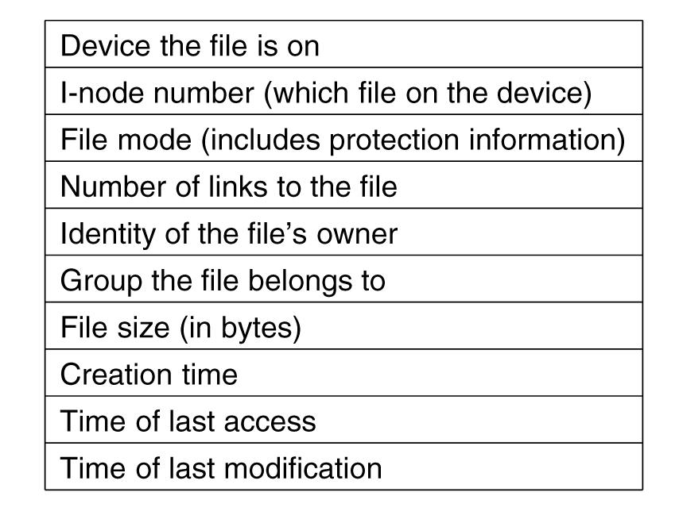
File System Calls in Linux (2)
Figure 10-28. The fields returned by the stat system call.
Tanenbaum, Modern Operating Systems 3 e, (c) 2008 Prentice-Hall, Inc. All rights reserved. 0-13-6006639

Slide 37
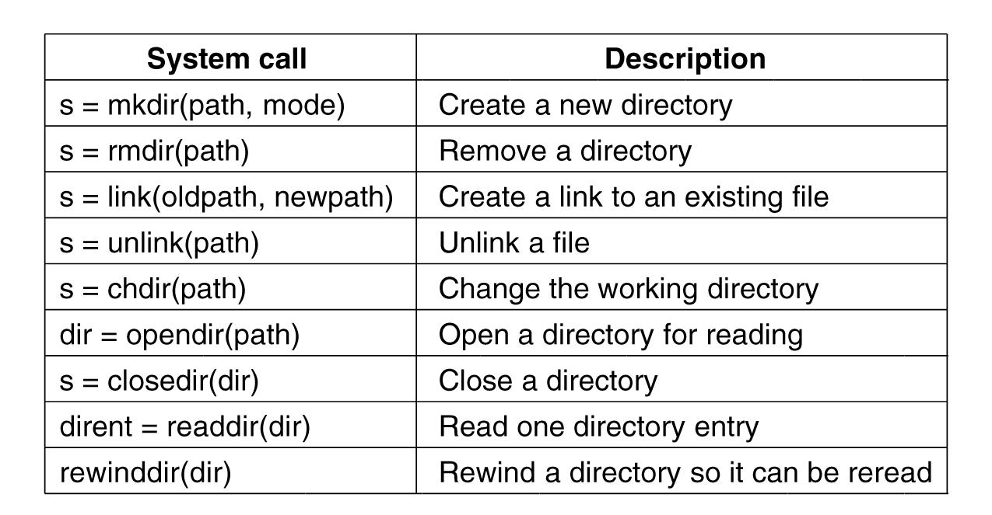
File System Calls in Linux (3)
Figure 10-29. System calls relating to directories.
Tanenbaum, Modern Operating Systems 3 e, (c) 2008 Prentice-Hall, Inc. All rights reserved. 0-13-6006639

Slide 38
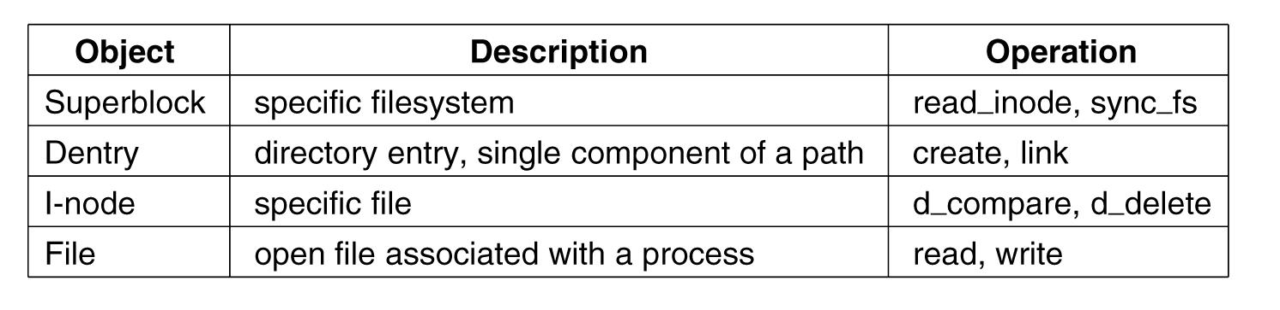
The Linux Virtual File System
Figure 10-30. File system abstractions supported by the VFS.
Tanenbaum, Modern Operating Systems 3 e, (c) 2008 Prentice-Hall, Inc. All rights reserved. 0-13-6006639

Slide 39
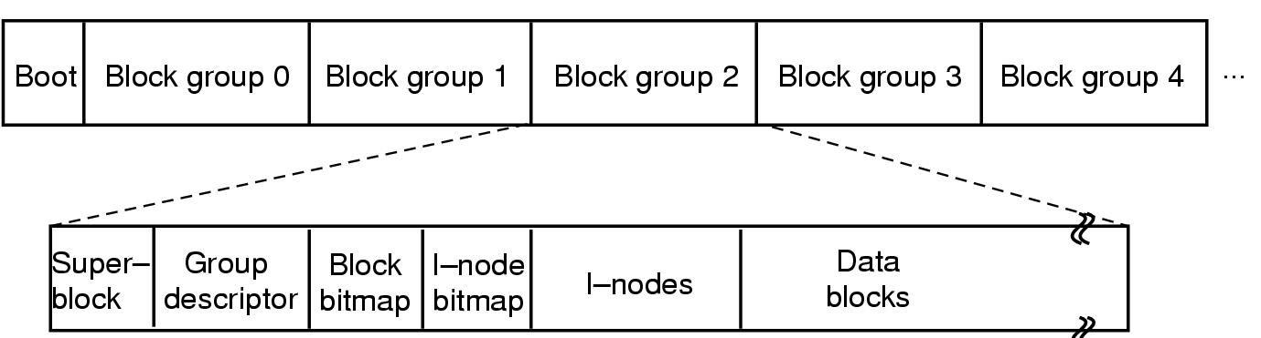
The Linux Ext2 File System (1)
Figure 10-31. Disk layout of the Linux ext2 file system.
Tanenbaum, Modern Operating Systems 3 e, (c) 2008 Prentice-Hall, Inc. All rights reserved. 0-13-6006639

Slide 40
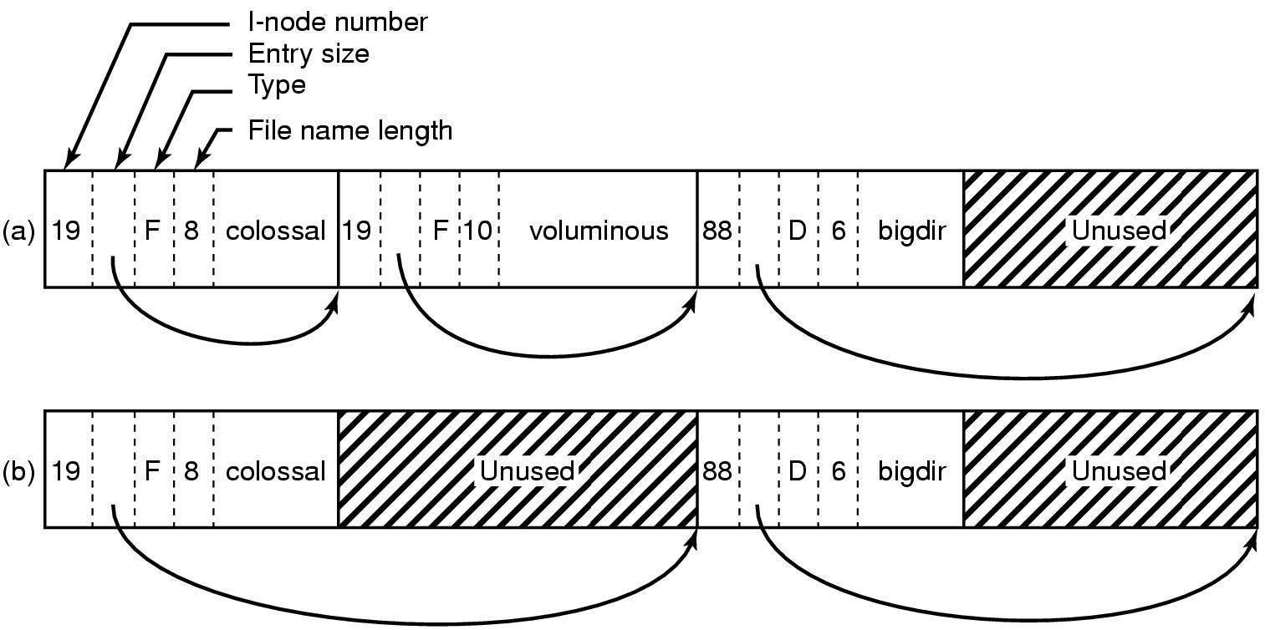
The Linux Ext2 File System (2)
Figure 10-32. (a) A Linux directory with three files. (b) The same directory after the file voluminous has been removed.
Tanenbaum, Modern Operating Systems 3 e, (c) 2008 Prentice-Hall, Inc. All rights reserved. 0-13-6006639

Slide 41
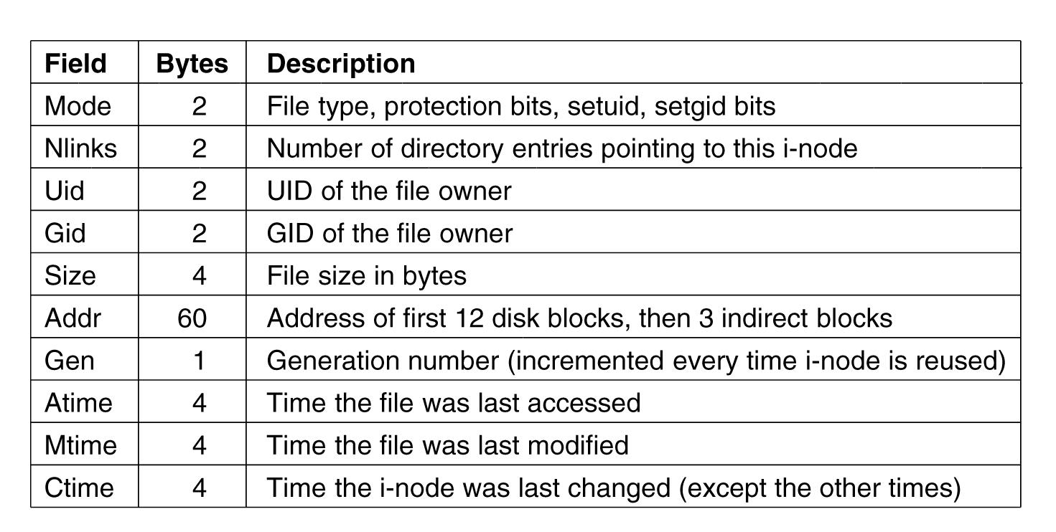
The Linux Ext2 File System (3)
Figure 10-33. Some fields in the i-node structure in Linux
Tanenbaum, Modern Operating Systems 3 e, (c) 2008 Prentice-Hall, Inc. All rights reserved. 0-13-6006639

Slide 42
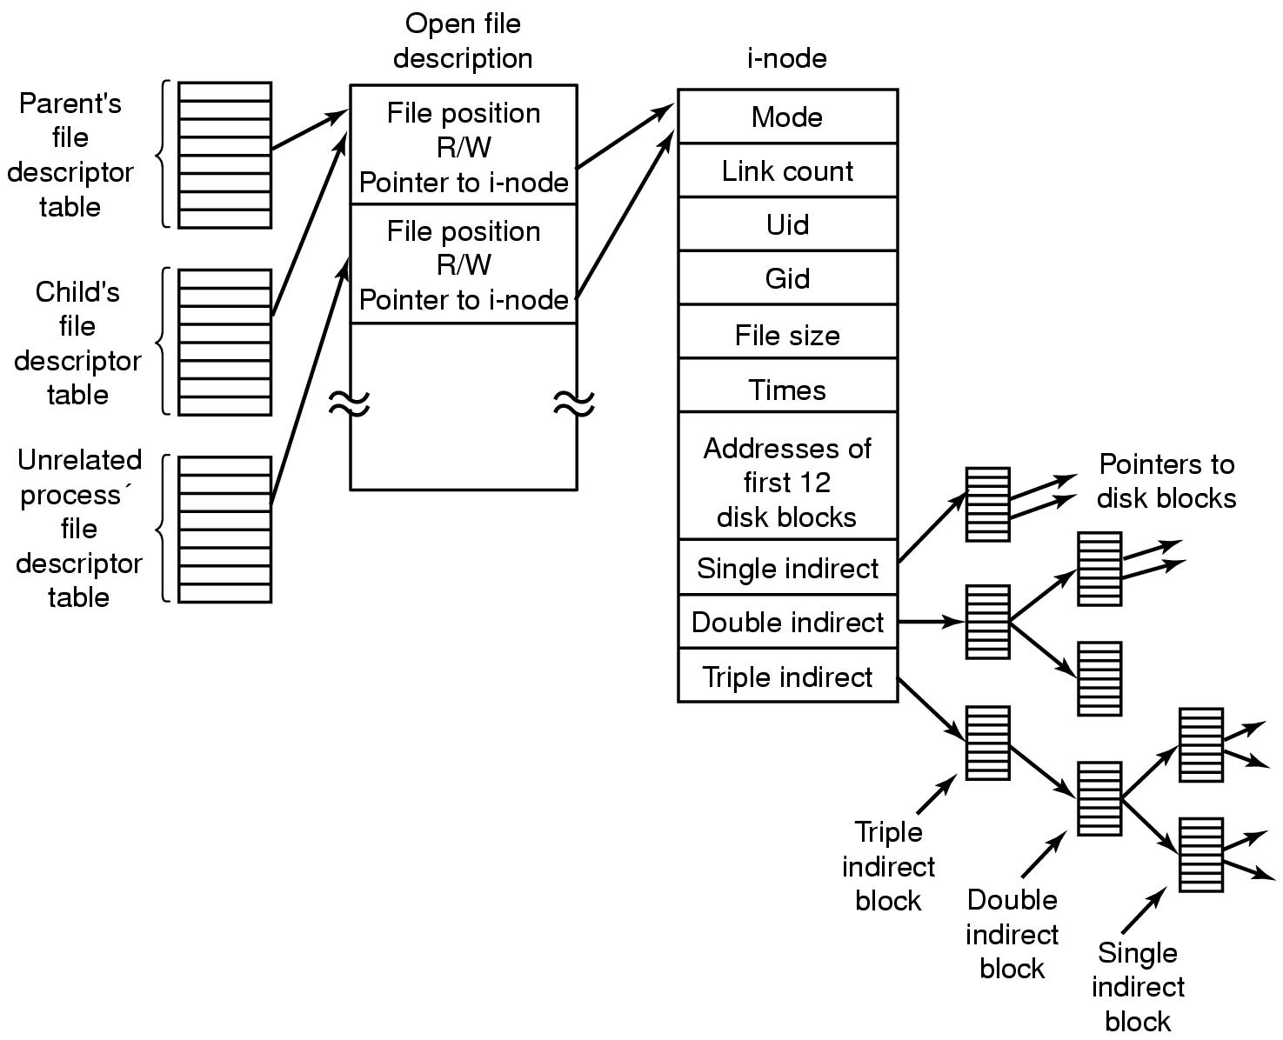
The Linux Ext2 File System (4)
Figure 10-34. The relation between the file descriptor table, the open file description table, and the i-node table.
Tanenbaum, Modern Operating Systems 3 e, (c) 2008 Prentice-Hall, Inc. All rights reserved. 0-13-6006639

Slide 43
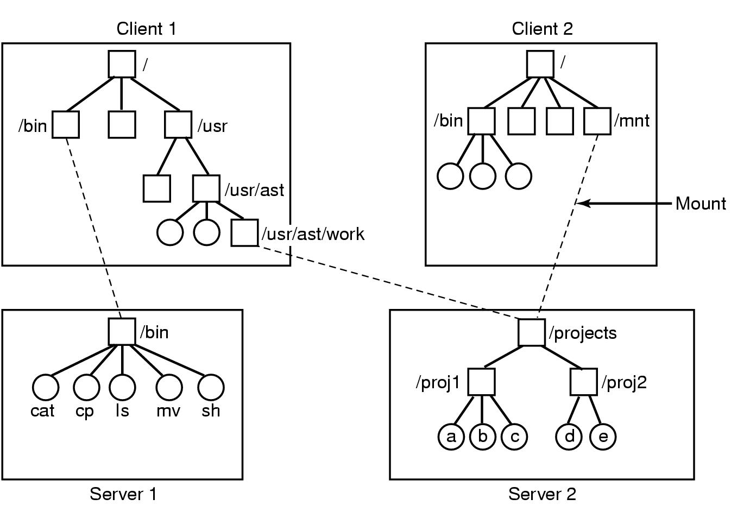
NFS Protocols
Figure 10-35. Examples of remote mounted file systems. Directories shown as squares, files shown as circles.
Tanenbaum, Modern Operating Systems 3 e, (c) 2008 Prentice-Hall, Inc. All rights reserved. 0-13-6006639

Slide 44
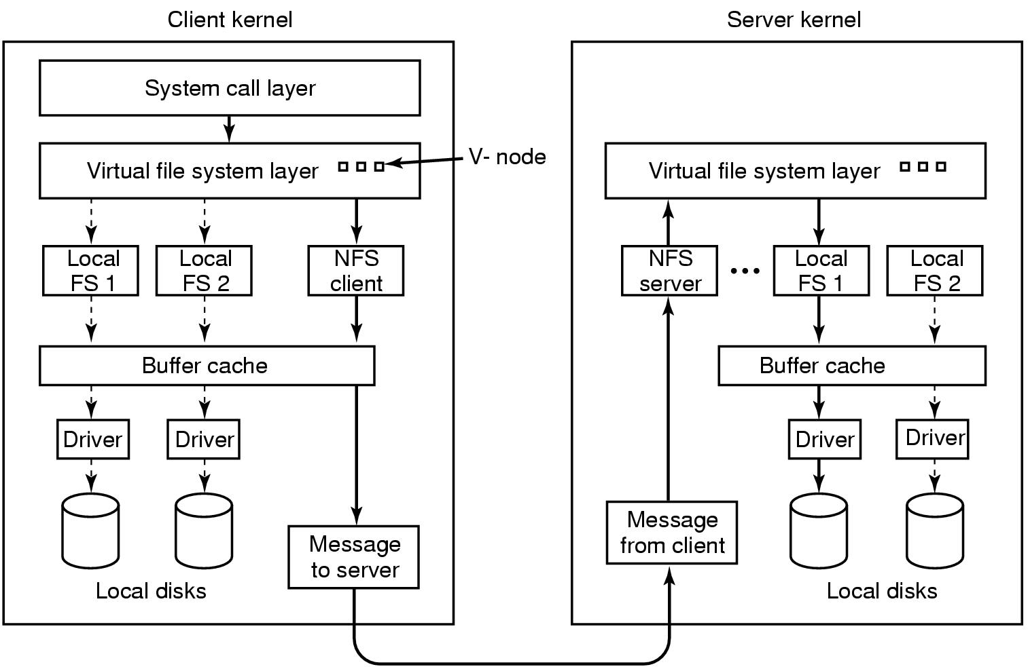
NFS Implementation
Figure 10-36. The NFS layer structure
Tanenbaum, Modern Operating Systems 3 e, (c) 2008 Prentice-Hall, Inc. All rights reserved. 0-13-6006639

Slide 45
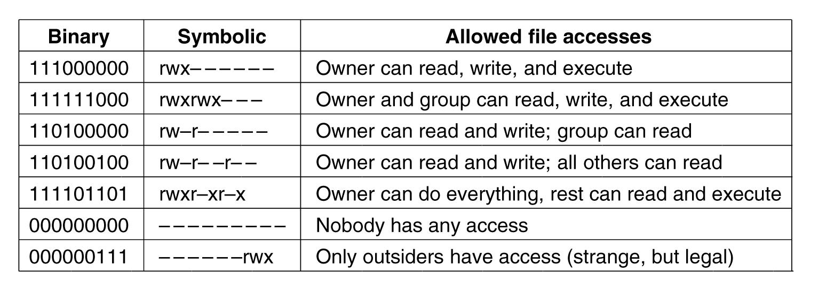
Security In Linux
Figure 10-37. Some example file protection modes.
Tanenbaum, Modern Operating Systems 3 e, (c) 2008 Prentice-Hall, Inc. All rights reserved. 0-13-6006639

Slide 46
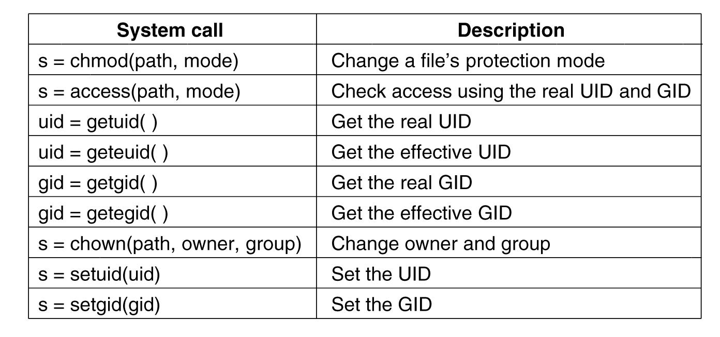
Security System Calls in Linux
Figure 10-38. system calls relating to security.
Tanenbaum, Modern Operating Systems 3 e, (c) 2008 Prentice-Hall, Inc. All rights reserved. 0-13-6006639

